Slide 1


Coordination systems for regulation in the field of Smart-Grids
Thesis progress report, February 2023
Philippe Glass
Start date : September 2022
Supervisor : Giovanna Di Marzo Serugendo
Progress report, February 2023

Slide 2


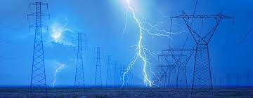




Motivations : the benefits of smart-grids
Allow to monitor production/distribution of energy.
Reduce energy costs.
Avoid peaks and shortages.
Decentralize distribution.
Promote renewable energy.
Make distribution more equitable.
Progress report, February 2023

Slide 3



Issue/Research questions/Artefact
The issues:
Grid Edge Devices do not yet manage energy exchanges in a collaborative and decentralized way.
It is difficult to manage renewable energy whose production is particularly fluctuating.
The research questions:
Model the notion of digital twins.
Provide a coordination mechanism, allowing Grid Edge Devices to collectively achieve various objectives.
Using the coordination model to introduce federated and distributed learning.
The expected artefact :
Coordination model for energy distribution and regulation at the microgrid level.
Progress report, February 2023

Slide 4

State of the art
Gamma model:
(inspired by chemistry)
[J.P. Banâtre “The gamma model and its disciplineof programming” (1990)]
[J. L.Fernandez-Marquez. “BIO-CORE : Bio-inspired Self-organising Mechanisms Core ( 2011)]
Models
of coordination
Multi-agent
systems
Holonic architecture at different levels:
[David Menga, ... “A Generic Holonic Control Architecture for Heterogeneous Multi-Scale SmartMicro-Grids..(2014) ]”
Coordination systems for regulation in the field of Smart-Grids
Machine learning
Decentralized Federated Learning:
[Wei Liu, Li Chen, and Wenyi Zhang : “Decentralized Federated Learning: Balancing
Communication and Computing Costs” 2022]
Progress report, February 2023

Slide 5










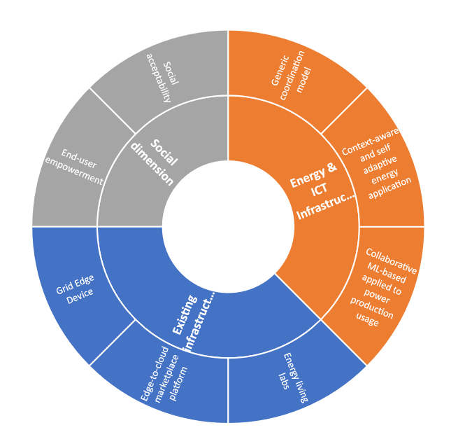
Context : the project ERA-NET LASAGNE ⁽¹⁾
Main axes:
Physical infrastructures
Energy & IT
Social dimension
Progress report, February 2023

Slide 6
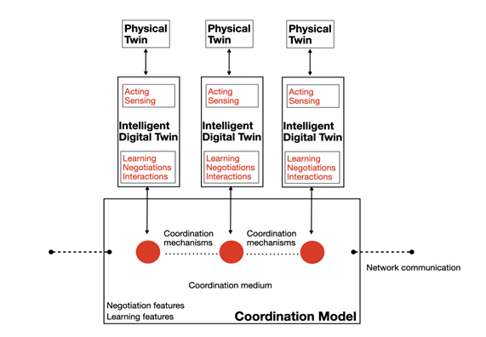
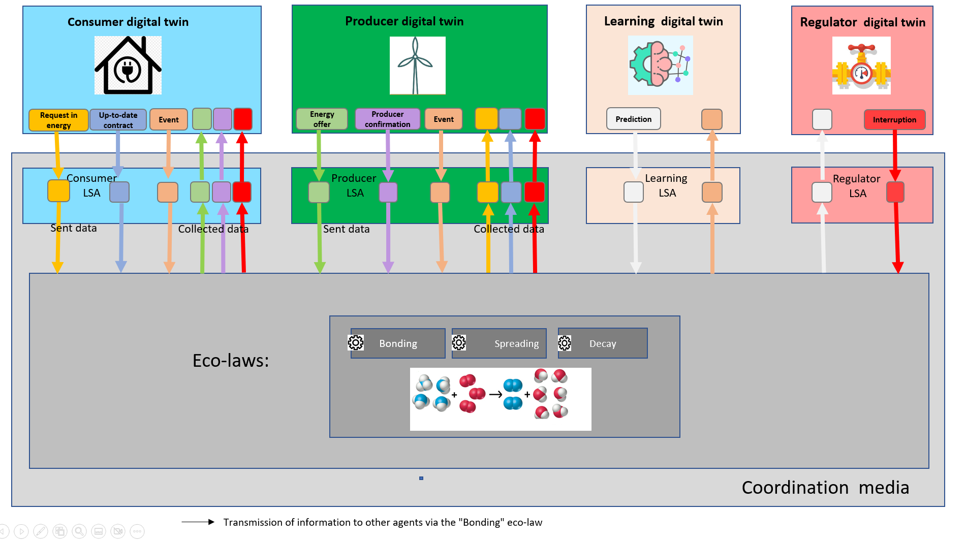
Method : conception & development ⁽¹⁾
Coordination model :
shared virtual environment (tuple space).
coordination laws.
Physical devices
Digital twins
Coordination model
Digital twins that interact through the model
Algorithms: contract/peak shaving.
Learning model: Markov chains.
Progress report, February 2023

Slide 7
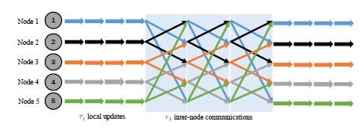
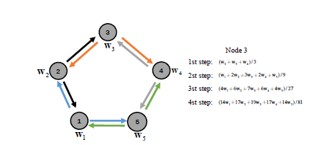
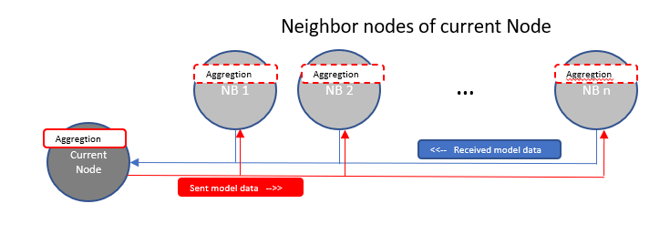
Method : conception & development ⁽²⁾
mechanism of Decentralized Federated Learning by using the platform:
Use of machine learning at each node level
Fully decentralized
Exchange of model data between nodes
Aggregation of model weights at each node (progressive aggregation)
=> Advantages:
network traffic reduced between nodes.
confidential data not shared.
Wei Liu, Li Chen, and Wenyi Zhang : Decentralized Federated Learning: Balancing
Communication and Computing Costs
Using of Gossip (aggregation + spreading).
Progress report, February 2023

Slide 8

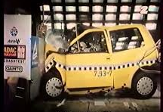

Method : evaluation procedure
Evaluation metrics:
Test scenarios:
Response time to meet demands.
Realist scenario based on consumption statistics.
Ratio of satisfied energy demands.
Realistic scenario in degraded mode.
Fairness of energy distribution.
Real-life scenario (data collected in “Les Verger”).
Capability to avoid a predicated event (over-production, shortage).
Crisis scenario:
Over-production/ Over-consumption.
Tragedy of the common.
Shortage.
Urgent demand.
Network configurations:
Single node -vs- 1 node/building
Progress report, February 2023

Slide 9
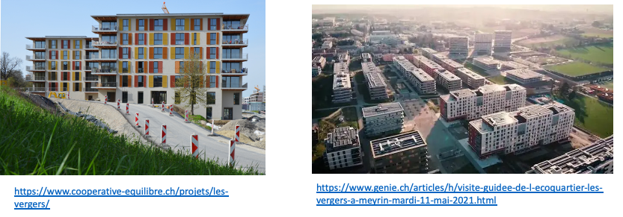
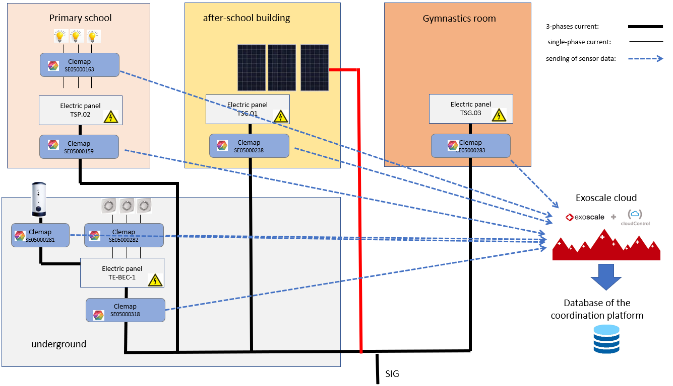
Collection of measures data from “Les Vergers” living lab (Meyrin)
Power measurements by smart-meters.
Storage of measurement history.
Progress report, February 2023

Slide 10
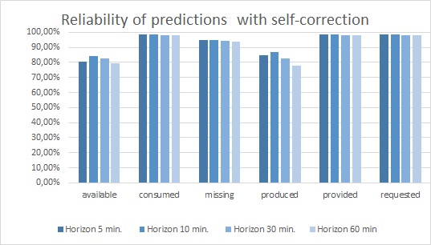
Results
Maximal response time to meet demands for electricity:
Prediction statistics (accuracy):
Progress report, February 2023

Slide 11
Current status : done + ongoing
Item | State of progress | Implemented | evaluated | Revised
 | Defined | Implemented | Evaluated | Revised
Coordination model
Digital twins producer, consumer, learning agent, regulator a series of algorithms and scenarios for establishing contracts
Realistic scenarios using statistic data of household consumption
Real-life scenarios using real data from “Les Vergers” Living Lab
Crisis scenarios (1) : over-production/consumption, urgent demand
Crisis scenarios (2) : tragedy of the common, Shortage
Integration of federated and distributed learning by using the platform
Integration of social acceptance by design
 | not started
 | On going
 | completed
Progress report, February 2023

Slide 12
Current status : not started yet
Item | State of progress | Implemented | evaluated | Revised
 | Def. | Impl. | Eval. | Revis.
Staggering of demand over time when energy availability is not sufficient.
Integration of energy pricing and of digital twins' policies regarding pricing.
Integration of negotiation between digital twins (peer-to-peer or using an organization such as an auction).
Integration of energy storage and adapting the behavior of digital twins for shortage prevention.
Modeling of pro-consumer digital twins.
Integration of contract generation for future needs.
Improvement of the visualization on the web application
Item | State of progress | Implemented | evaluated | Revised
Submission of the thesis subject
Preparation/submission of papers MDPI Journal Sensor IEEE Transaction on Smartgrids JASSS – The Journal of Artificial Societies and Social Simulation
Progress report, February 2023

Slide 13

Questions
Progress report, February 2023

Slide 14
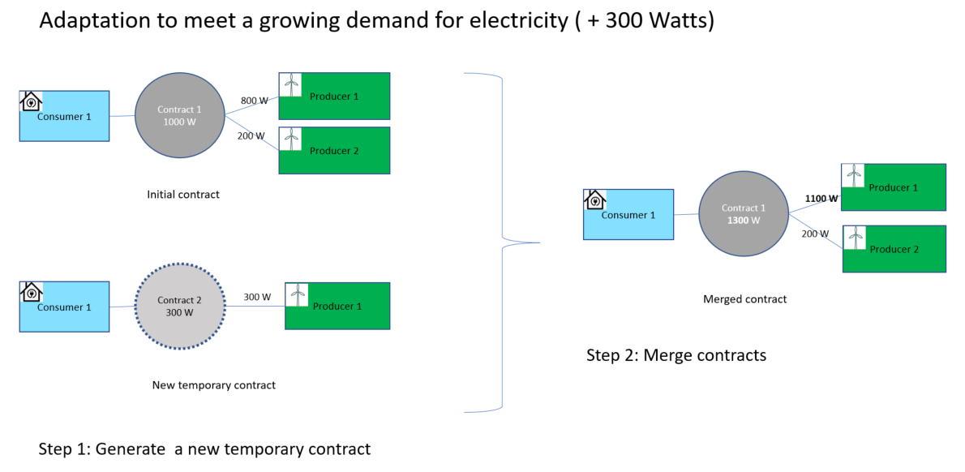
Improvement of the digital twins (done)
Testing of the consumer/producer digital twins by using the data collected from Les Vergers.
Consideration of the fluctuation in demands
Use of a margin in a contract to absorb the power variation
Use of a second « transition contract » when the variation is more important.
Progress report, February 2023

Slide 15
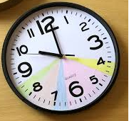

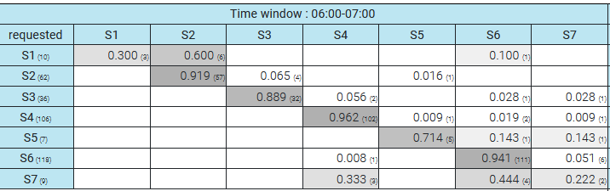
Learning model: use of Markov chains
State of the node
=> 6 variables: wattage demanded, produced, consumed, provided, missing and available
Definition of Markov states
Cutting of the variable space (time slots)
Recording the number of observations
Transition matrix
Progress report, February 2023
15

Slide 16
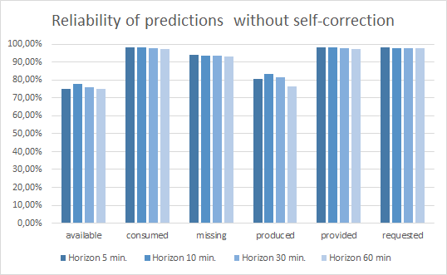
Improvement of the learning model
Training the model using data from Les Vergers
Evaluation of the model by comparing the predicted states with the actual state distribution
Generation of prediction statistics to better understand the difficulties encountered by the model.
Auto-correction mechanism executed by the model.
Progress report, February 2023

Slide 17
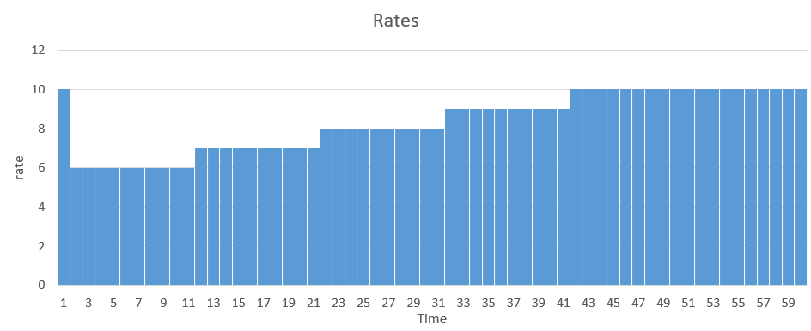
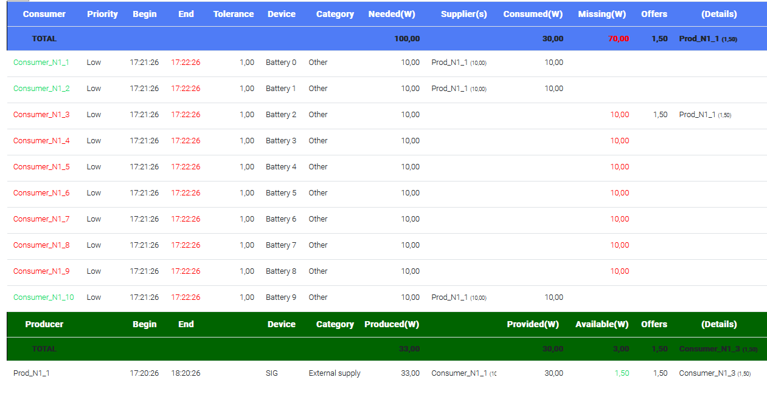
Scenario “Tragedy of the common” (ongoing)
Rates of electricity set by a producer :
Results :
10 demands at the same time (10 x 10 Watts) :
only 3/10 can be satisfied
33 Watts produced
Progress report, February 2023

Slide 18
Next steps
Staggering of demand over time when energy availability is not sufficient.
Integrate energy pricing and identify possible policies that consumers and producers can adopt.
Integrate negotiation between producers and consumers(peer-to-peer or using an organization such as an auction).
Managing energy storage and adapting the behavior of digital twins for shortage prevention.
Provide the ability to generate a contract for a future need.
Modeling pro-consumer digital twins (both producer and consumer).
Improve the visualization on the web application, by making the views more intuitive.
Progress report, February 2023

Slide 19
Publications : TODO
Repositories on the UNIGE open archive ::
https://archive-ouverte.unige.ch/unige:155369 :
Plateforme de coordination et collaboration pour échanger l'énergie, réguler et prédire la production/consommation dans le cadre d'un réseau électrique intelligent (octobre 2021)
https://archive-ouverte.unige.ch/unige:164521 :
Lasagne –implementation of smartgrid in the form of a coordination system of digital twins
(Poster presented at the Data Science Day on September 15, 2022)
In Progress :
Coordination and collaboration platform to exchange energy, regulate and predict production and consumption in the context of smart grids
MDPI Journal Sensor
IEEE Transaction on Smartgrids
Social Acceptance by design
JASSS – The Journal of Artificial Societies and Social Simulations
Progress report, February 2023

Slide 20
Methods : evaluation procedure
Ability to provide energy
Evaluation | Synopsis | Measure unit | Conditions | #agents
Response time | Average and maximal response time to respond to the demand in electricity | Seconds
Percentage not provided | Ratio of energy not provided due to poor response times | Ratio in %
Fairness | Fairness of energy distribution
Cost | Cumulated cost of energy
Ability to predict
Evaluation | Synopsis | Measure unit | Conditions | #agents
Model accuracy | Ration of successful predictions | Accuracy ratio in %
Prediction capacity | Capacity of predicting a specified event (over-production, over-consumption, shortage) | Predicted probability in %
Proactive behavior to avoid a crisis
Evaluation | Synopsis | Measure unit | Conditions | #agents
Proactive action | Capacity to avoid a specified event thanks to prediction and the use of self adaptation : over-production, over-consumption, shortage | Boolean (succeed of failed)
Progress report, February 2023

Slide 21
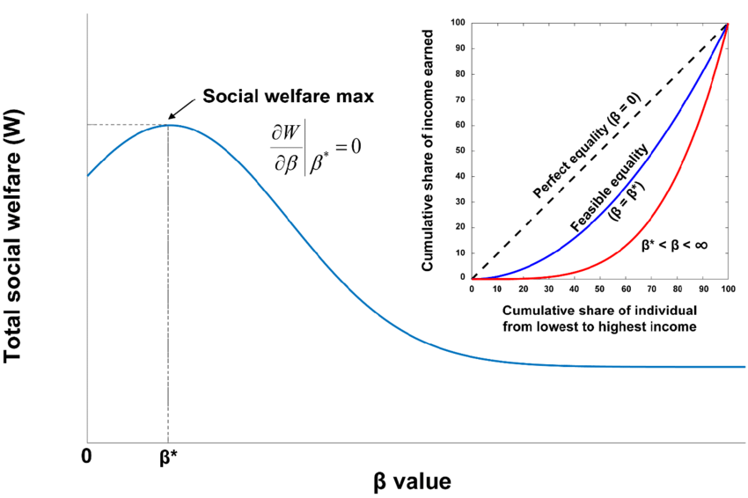

Method : conception & development ⁽⁴⁾
Mechanism of contract/negotiation by integrating criteria of social acceptance
Modeling of individual/social welfare with different criteria
consumption, cost, sustainability, involvement vs free-riding
Modeling of criteria evaluation
Modeling of agent’s utility function
Agent #i : Profile = {λ¹_{i}, λ²_{i}, ….. , λ^{p}_{i}}
Offer: ω
utility: ω -> λ¹_{i}*e¹(ω) + … + λ^{p}_{i} * e^{p}(ω)
U_{i}(ω)
Modeling of negotiation bilateral negotiation
Modeling of organized market (auctions)
Progress report, February 2023

